Slide 1
UPnP & DLNA
Speaker: Yi-Lei Chang
Advisor: Dr. Kai-Wei Ke
2012/03/27

Slide 2
Outline
Introduction
UPnP
DLNA
Example - DLNA Family Intercom System
Reference

Slide 3
Introduction
Networking is easy, except…
  Network is unreliable
  Programs need to talk to programs
    But software is heterogeneous
  Must upgrade system piece at a time

Slide 4
UPnP
UPnP → Universal Plug-and-Play
Describe the protocols for communication between
  Control point (CP)
    Controllers
  Device
    Provide services
  An actual device might contain both functions

Slide 5
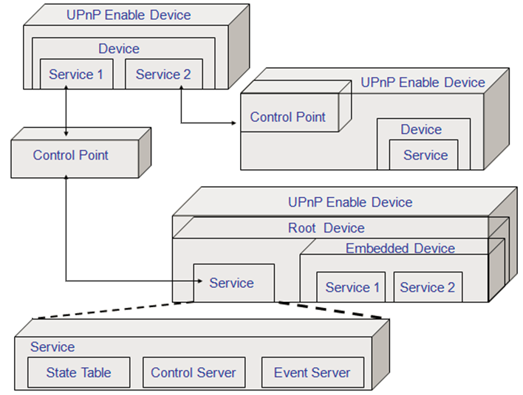
UPnP - CP, Device & Service
?
?

Slide 6
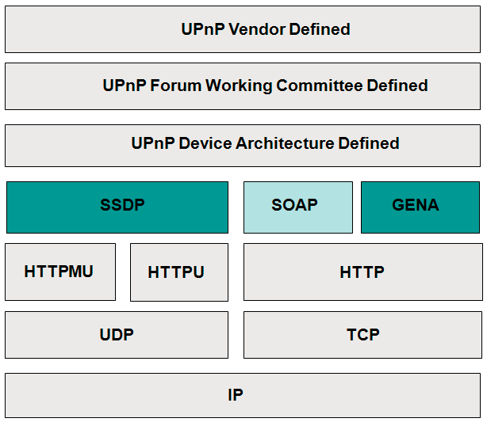
UPnP - Protocol Stack

Slide 7
Steps to UPnP Networking
Addressing
  CP and device get addresses
Discovery
  CP finds interesting device
Description
  CP learns about device capabilities
Control, Eventing and Presentation
  CP invokes actions on device
  CP listens to state changes of device
  CP views device status using HTML UI

Slide 8
UPnP - Addressing
Use DHCP
If DHCP not work
  Auto IP
  Periodically try DHCP
UPnP Device Architecture 1.1 Support IPv6

Slide 9
UPnP - Discovery
  Use SSDP (Simple Service Discovery Protocol)
Control points
  Find interesting device/service
  All/filter
Device
  Advertise when added
  Refresh advertisements
  Cancel advertisements when removed
  Response search request

Slide 10
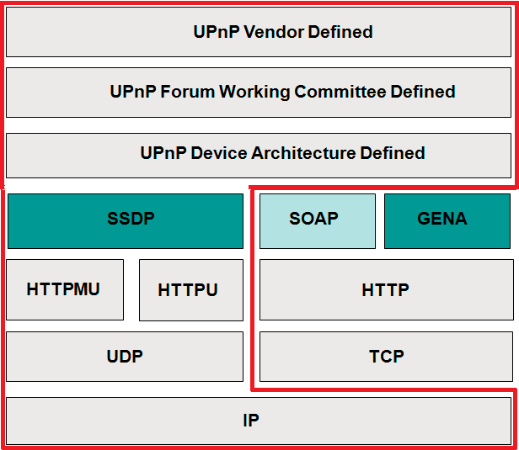
Discovery - Protocol Stack

Slide 11
Discovery - Packet
Advertising
  NOTIFY * HTTP/1.1
  HOST: 239.255.255.250:1900
  LOCATION: URL for UPnP description for root device
  NT: notification type
  NTS: ssdp:alive
Searching
  M-SEARCH * HTTP/1.1
  HOST: 239.255.255.250:1900
  MAN: "ssdp:discover"
  MX: seconds to delay response
  ST: search target
Responding
  HTTP/1.1 200 OK
  LOCATION: URL for UPnP description for root device
  ST: search target

Slide 12
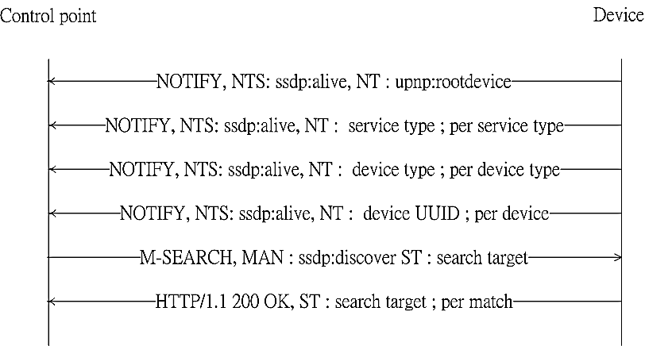
Discovery - Sequence Diagram

Slide 13
UPnP - Description
Control point
  learns about device capability
  Use URI from discovery step to get device description
  Use URI from device description to get service description
Device
  Declare capability
    Type
    Physical
    Logical (Service)
    UI

Slide 14
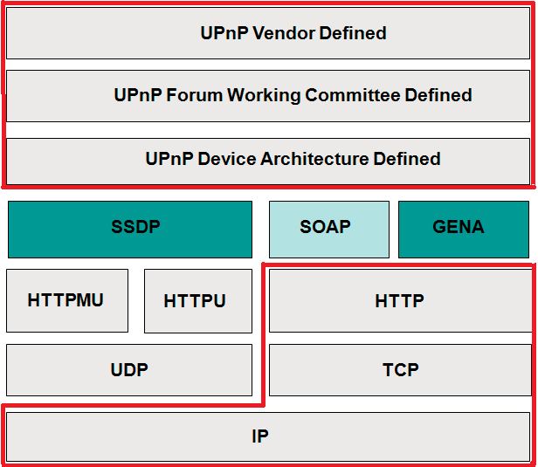
Description - Protocol Stack

Slide 15
Description - Packet
Description request
  GET /descriptionPath HTTP/1.1
  HOST: hostname:portNumber
  ACCEPT-LANGUAGE: language preferred by control point
Description response
  HTTP/1.1 200 OK
  CONTENT-LANGUAGE: language used in description
  CONTENT-TYPE: text/xml; charset="utf-8"
  XML Description

Slide 16
Description - Device Description
<?xml version="1.0"?>
<root ns="urn:schemas-upnp-org:device-1-0"
configId="configuration number">
……
<device>
<deviceType>urn:schemas-upnp-org:device:deviceType:v</deviceType>
……
<UDN>uuid:UUID</UDN>
……
<serviceList>
<service>
<serviceType>urn:schemas-upnp-org:service:serviceType:v</serviceType>

Slide 17
Description - Device Description
<serviceId>urn:upnp-org:serviceId:serviceID/serviceId>
<SCPDURL>URL to service description</SCPDURL>
<controlURL>URL for control</controlURL>
<eventSubURL>URL for eventing</eventSubURL>
</service>
……
</serviceList>
<deviceList>
……
</deviceList>
<presentationURL>URL for presentation</presentationURL>
</device>
</root>

Slide 18
Description - Service Description
<?xml version="1.0"?>
<scpd
……
<actionList>
<action>
<name>actionName</name>
<argumentList>
<argument>
<name>argumentNameIn1</name>
<direction>in</direction>
<relatedStateVariable>stateVariableName</relatedStateVariable>
</argument>

Slide 19
Description - Service Description
……
</actionList>
<serviceStateTable>
<stateVariable sendEvents="yes"|"no" multicast="yes"|"no">
<name>variableName</name>
<dataType>basic data type</dataType>
<defaultValue>default value</defaultValue>
……
</stateVariable>
……
<serviceStateTable>
</scpd>

Slide 20
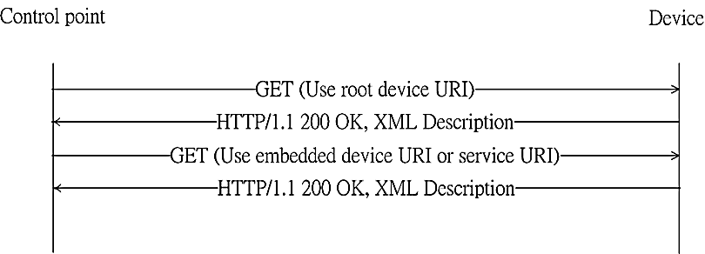
Description - Sequence Diagram

Slide 21
UPnP - Control
Use SOAP → Simple Object Access Protocol
Control point
  Invokes actions on device
  Use URI from description step to send actions to device
Device
  Response action result

Slide 22
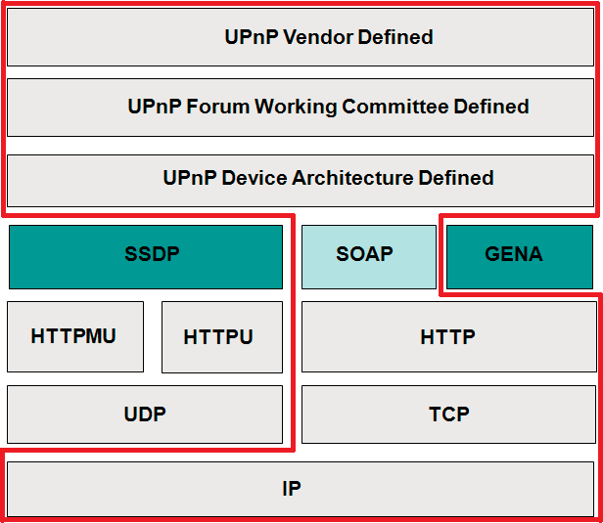
Control - Protocol Stack

Slide 23
Control - Packet
Action invocation
  POST path control URL HTTP/1.1
  HOST: hostname:portNumber
  u:actionName xmlns:u="urn:schemas-upnp-org:service:serviceType:v
  argumentName in arg value
Action Response
  HTTP/1.0 200 OK
  u:actionNameResponse xmlns:u="urn:schemas-upnp-org:service:serviceType:v
  argumentName out arg value
Action error response
  HTTP/1.1 500 Internal Server Error
  Faultstring UPnPError
  errorCode error code
  errorDescription error string

Slide 24
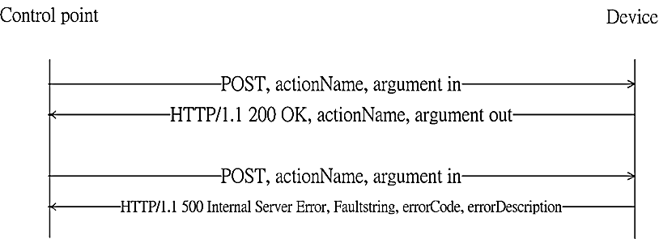
Control - Sequence Diagram

Slide 25
UPnP - Eventing
Use GENA → General Event Notification Architecture
Control point
  Use URI from description step to subscribe to events from device
Device
  Notify

Slide 26
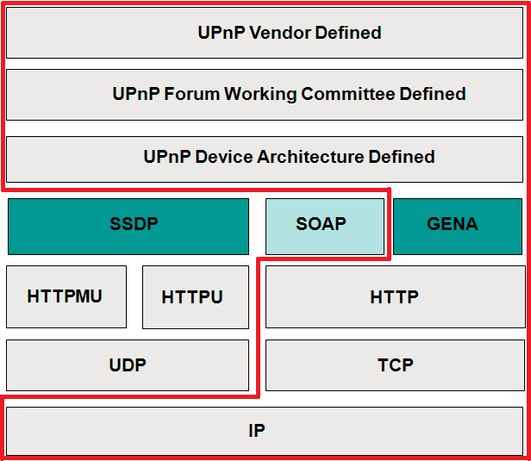
Eventing - Protocol Stack

Slide 27
Eventing - Packet
SUBSCRIBE with NT and CALLBACK
  SUBSCRIBE publisher path HTTP/1.1
  CALLBACK: <delivery URL>
  NT: upnp:event
  TIMEOUT: Second-requested subscription duration
Response
  HTTP/1.1 200 OK
  SID: uuid:subscription-UUID
  TIMEOUT: Second-actual subscription duration

Slide 28
Eventing - Packet
Event message
  NOTIFY delivery path HTTP/1.1
  NT: upnp:event
  NTS: upnp:propchange
  SID: uuid:subscription-UUID
  SEQ: event key
  e:propertyset
  e:property
  variableName new value

Slide 29
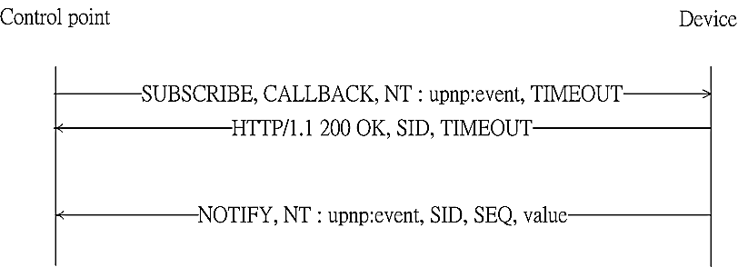
Eventing - Sequence Diagram

Slide 30
UPnP - Presentation
Control point
  views device status using HTML agent
Don not constrain implementation

Slide 31
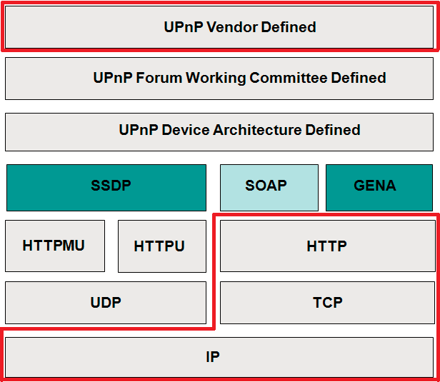
Presentation - Protocol stack

Slide 32
DLNA
DLNA → Digital Living Network Alliance
Goal: Establish an ecosystem of compatible products for networked media devices
Develops standards-based specifications
  DLNA Guidelines

Slide 33
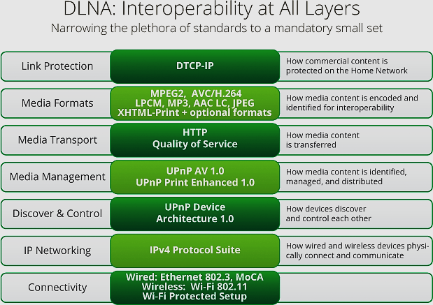

Slide 34
DLNA - Device Class
Home Network Devices
Mobile Handheld Device
Home Infrastructure Device
Digital Media Server
Mobile Digital Media Server
Mobile Network Connectivity Function
Digital Media Player
Mobile Digital Media Player
Digital Media Renderer
Mobile Digital Media Downloader
Mobile Interoperability Unit
Digital Media Controller
Mobile Digital Media Uploader
Digital Media Printer
Mobile Digital Media Controller

Slide 35
DLNA - Media Format
For Home Device
Media Formats | Required Formats Set | Optional Formats Set
Imaging | JPEG | GIF.TIFF.PNG
Audio | LPCM( 2 Channel) | MP3.WMA9. AC-3.AAC.ATRAC3plus
Video | MPEG2
For Mobile/Handheld Devices
Media Formats | Required Formats Set | Optional Formats Set
Imaging | JPEG | GIF.TIFF.PNG
Audio | MP3 and MPEG4 AAC LC | MPEG4 (HE AAC, AAC LTP, BSAC), AMR, ATRAC3plus, G.726, WMA, LPCM
Video | MPEG4 AVC (AAC LC Assoc Audio) | VC1, H.263, MPEG4 part 2, MPEG2, MPEG4 AVC (BSAC or other for Assoc. Audio)

Slide 36
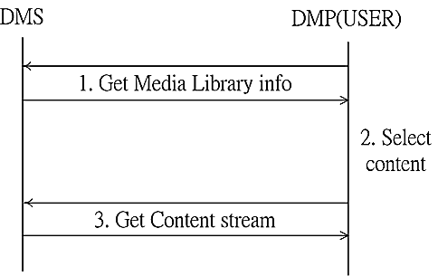
DLNA - Work Model 2-Box
Pull

Slide 37
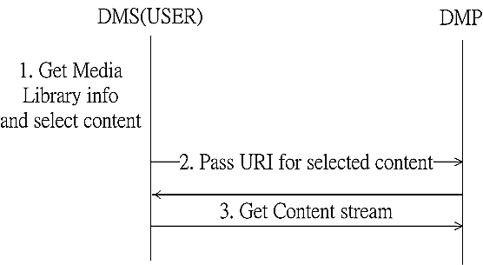
DLNA - Work Model 2-Box
Push

Slide 38
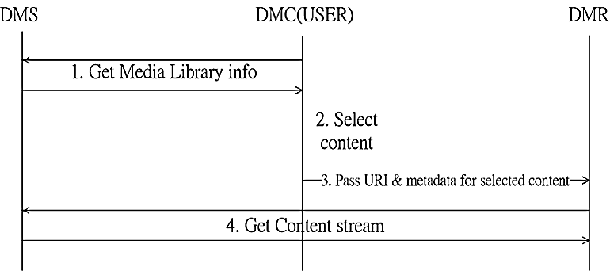
DLNA - Work Model 3-Box

Slide 39
An example - DFIS
DFIS → DLNA Family Intercom System
Traditional intercom system
  Only allows place-to-place communication
  Necessary to dial the extension number of a specific family member
DFIS
  Support user mobility
  Without the knowledge of the extension number that caters to a fixed location

Slide 40
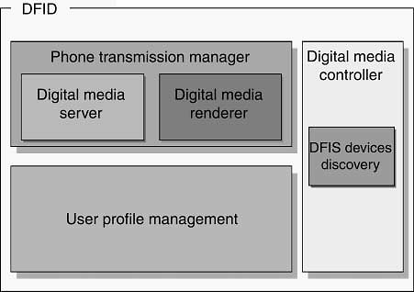
DFIS - System Architecture
DFID → DLNA Family Intercom Device
  User profile management
  DFIS device discovery

Slide 41
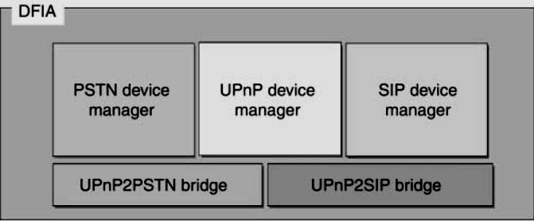
DFIS - System Architecture Cont.
DFIA → DLNA Family Intercom Adapter
  PSTN Device Management (DM)
    Forward PSTN signal to UPnP DM (to convert PSTN devices to virtual DFIDs)
    Dial PSTN through FXS
  UPnP DM
    Forward DFID list to SIP/PSTN DM (To convert DFIDs to virtual SIP/PSTN Device)
    Create virtual DFIDs for SIP/PSTN devices
  SIP DM
    Forward SIP proxy registered message to UPnP DM (To convert SIP devices to DFIDs)
    Create virtual SIP devices for DFIDs
UPnP2PSTN Bridge
UPnP2SIP bridge

Slide 42
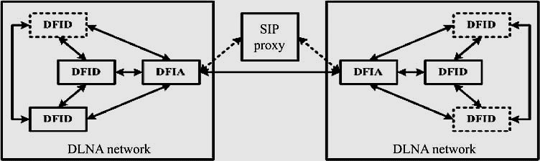
DFIS - Simulation environment

Slide 43
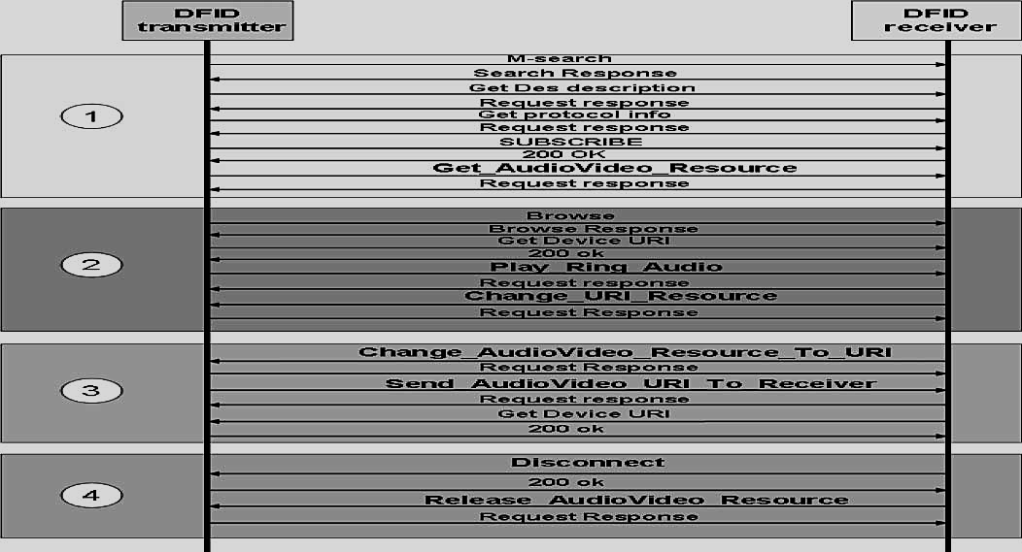
The basic flows of a simple call process

Slide 44
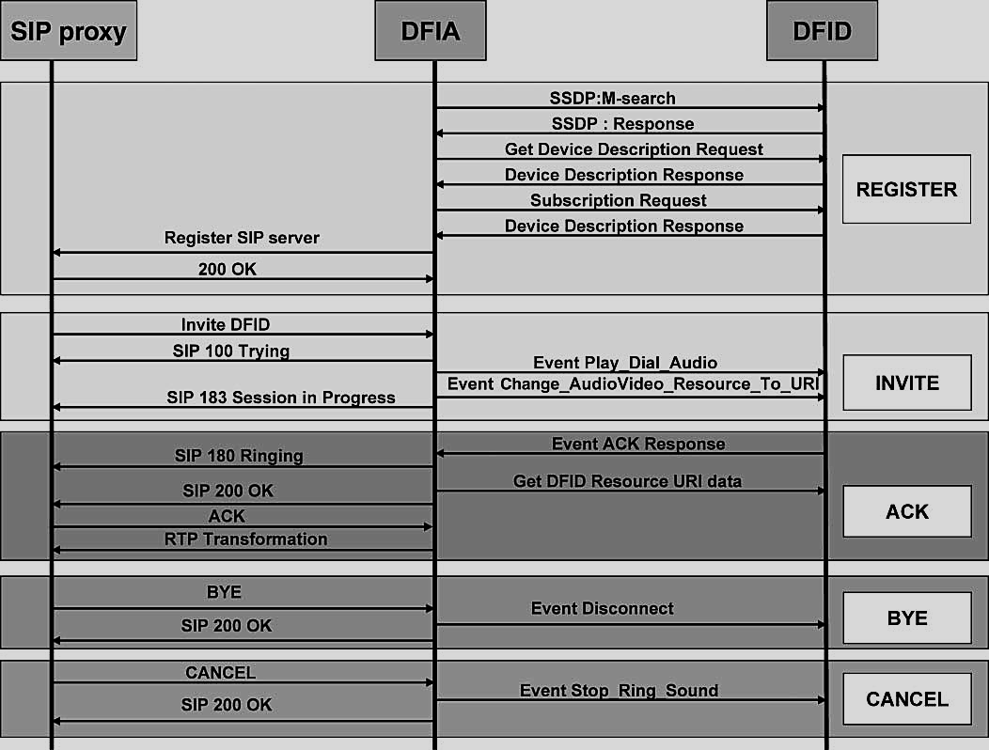
The message flows in UPnP utilizes events

Slide 45
Reference
[1] Contributing Members of the UPnP Forum, “UPnP™ Device Architecture 1.1,” October 15, 2008. Retrieved March 18, 2012 from World Wide Web: http://www.upnp.org/specs/arch/UPnP-arch-DeviceArchitecture-v1.1.pdf.
[2] Contributing Members of the UPnP Forum, “UPnP™ Device Architecture 1.0,” April 24, 2008. Retrieved March 10, 2012 from World Wide Web: http://www.upnp.org/specs/arch/UPnP-arch-DeviceArchitecture-v1.0.pdf.
[3] Digital Living Network Alliance, “How It Works,” 2012. Retrieved March 10, 2012 from World Wide Web: http://www.dlna.org/dlna-for-industry/digital-living/how-it-works.
[4] Allegro Software Development Corporation, “Networked Digital Media Standards: A UPnP/DLNA Overview,” 2006. Retrieved March 12, 2012 from World Wide Web: http://www.allegrosoft.com/UPnP_DLNA_White_Paper.pdf
[5] Chin-Feng Lai, Hsien-Chao Huang, Yueh-Min Huang and Han-Chieh Chao, “Design and Implementation of the DLNA Family Intercom System for Smart Homes,” Computer Journal, Vol. 52, No. 8, pp. 960-968.

Slide 46
Thanks for Listening
Q&A

